Slide 1
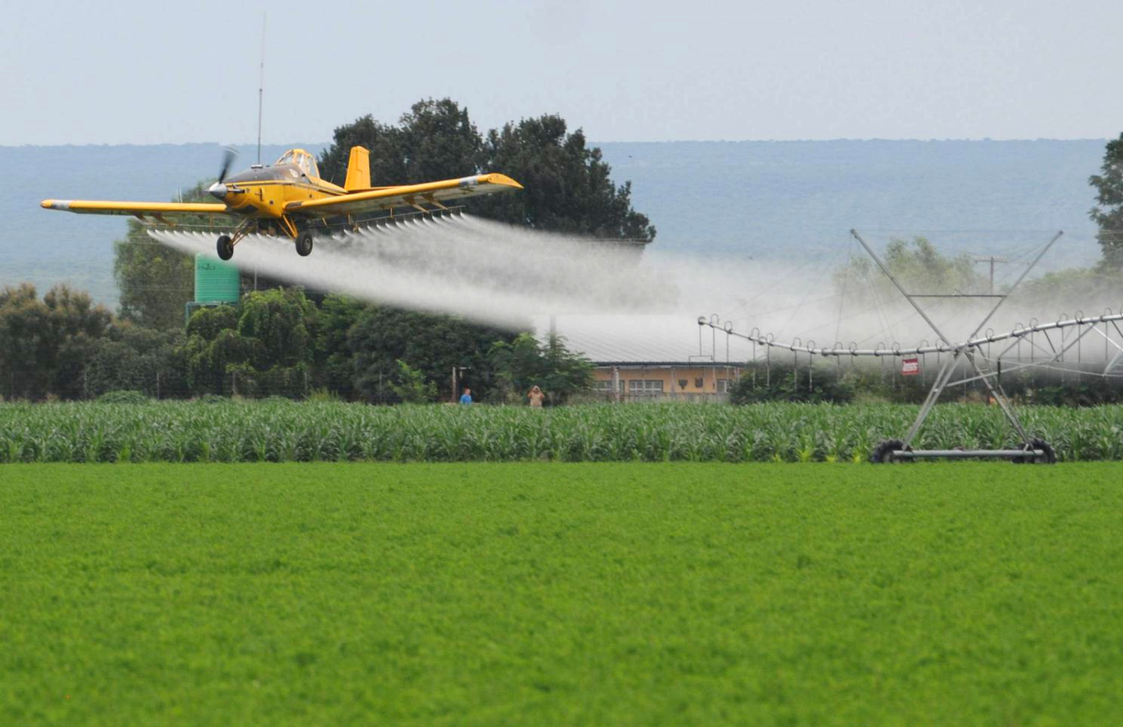
Risk Assessment of genetically modified (GM) plants and the Precautionary Principle
Thomas Bøhn PhD
Research Professor
GenØk Centre for Biosafety, Tromsø, Norway
thomas@genok.org

Slide 2
Topics for today
Open and contained use of biotechnology
GM plants and traits on the market today
Todays great challenges
Ecology and the Precautionary Principle

Slide 3
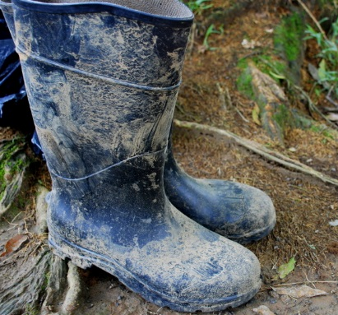
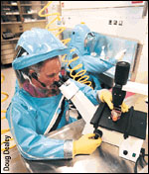
Biotechnology today
Open use (agriculture)
Contained use (medical)
Notes:
GM crops 170 mill hectare
Resistance evolution
increased use of toxins (dose/applications/stacking of traits)
more important to test in practice
Resistance evolution and gene ecology – THEORY
GM Plants and pesticides – REAL LIFE PRODUCTS AS FOOD AND RESIDUES – HEALTH RELEVANT

Slide 4
Genetically modified plants on the market
Open use (agriculture)
GM plants
Maize Soybean Cotton Canola
(Major food/feed products globally)
GM traits
Insect resistance
(Bt-toxins)
Herbicide resistance
(Roundup)
~ 95 % of GM plants
Resistance Evolution
Notes:
GM crops 170 mill hectare
Resistance evolution
increased use of toxins (dose/applications/stacking of traits)
more important to test in practice
Resistance evolution and gene ecology – THEORY
GM Plants and pesticides – REAL LIFE PRODUCTS AS FOOD AND RESIDUES – HEALTH RELEVANT

Slide 5



Great challenges!
150 years ago
Biodiversity
Chemical pollution
Climate change
Sustainable development
Food production
(GMOs, synthetic biology, converging technologies...)
Human population
Notes:
Why is biodiversity important? Biodiversity is the richness of living organisms. This is what we may respond with in a changing world: climate change, pollution, invasive speces, etc all these same threats may force us to respond, adapt to new conditions. And the raw material which we can use is the rich gene pools and biodiversity in general.
We often talk about the positive effects of synergies. For example we may say that with you participants with overlapping and high competence in risk assessment, we may as a whole achieve much more than the sum of the individual part. There is a positive synergy of the group.
Negative synergies are the opposite. Meeting more than one stress factor may make us collapse
UNDERLYING ALL OF THESE is the overall ECOLOGICAL FOOTPRINT OF THE HUMANS:
INCREASES IN HUMAN NUMBERS (last 150 years a sevenfold increase)
per capita IMPACTS (last 150 years a sevenfold increase)
THEREFORE THE ECOLOGICAL FOOTPRINT HAS BECOME ABOUT 50 TIMES HIGHER IN THE LAST 150 YEAR

Slide 6
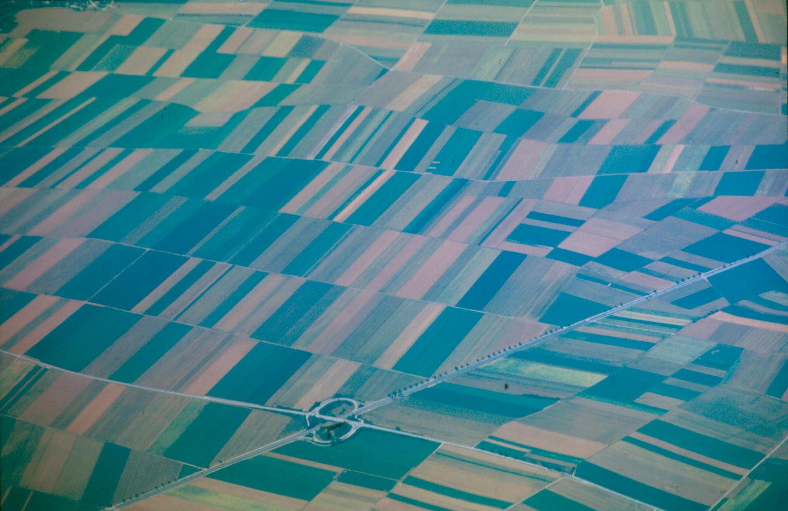
Birds eye view

Slide 7
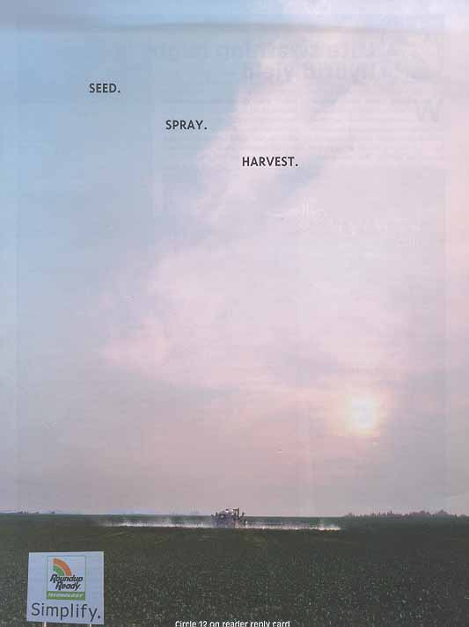
Notes:
Sett fra bakken (Monsanto).
Reklameplakat for hvordan jordbruket skal foregå.
Jorden er mørkelagt men himmelen er høy

Slide 8
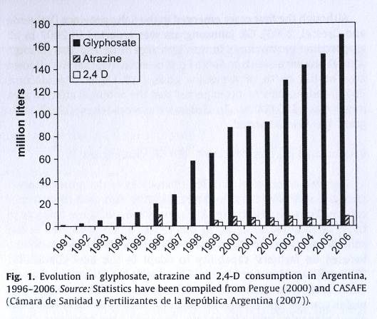

Herbicide tolerant crops and resistance development
  Herbicide use
  Tolerant weeds
  Increased use
  Increased tolerance
  Addition of other chemicals
From Binimelis et al (2009)
Notes:
Tolerance – ok you can handle that one, but try this!

Slide 9

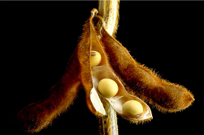
Important biosafety questions:
Are glyphosate-based herbicides toxic?
Can we find glyphosate residues in glyphosate tolerant soy?

Slide 10
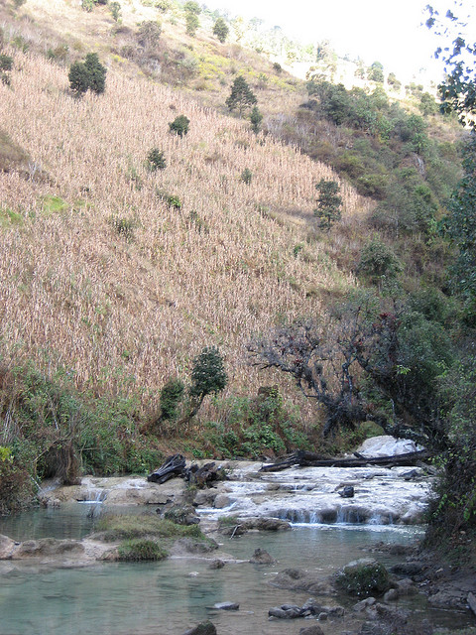
Soil
Ecology
Crops impact ecosystems
Terrestrial
Soil
Aquatic
Terrestrial
Aquatic

Slide 11
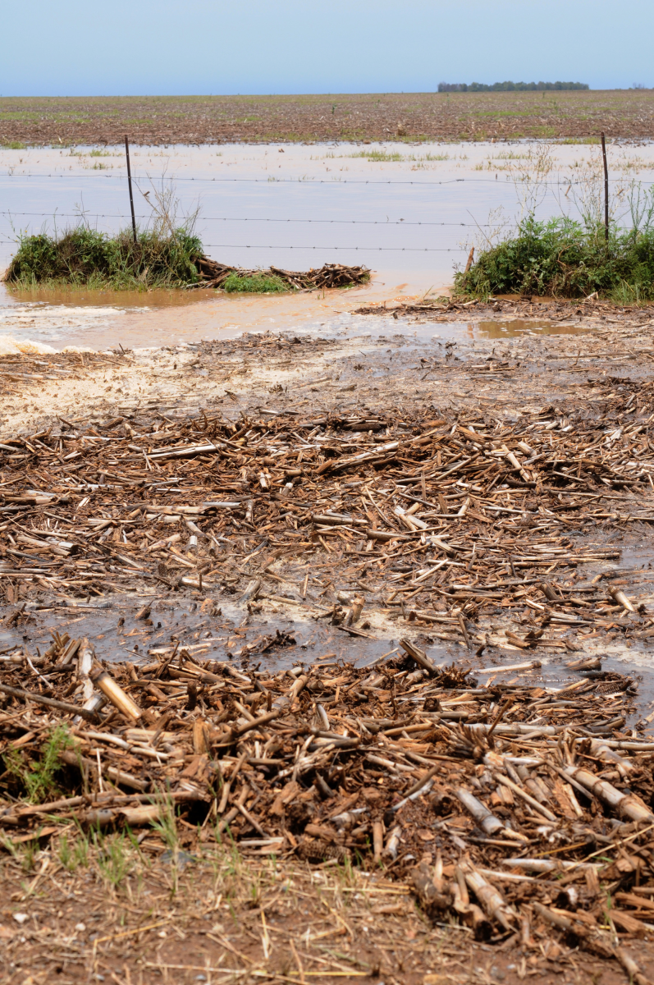
The aquatic environment
Main input energy to aquatic ecosystems
  Allochtonous plant parts
  Including Bt toxin(s)
  Herbicide residues
Run-off and drift from spraying
  Pesticides
  Herbicides

Slide 12
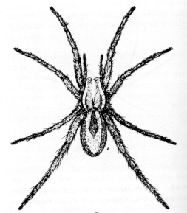

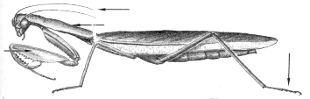
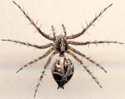

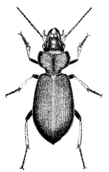
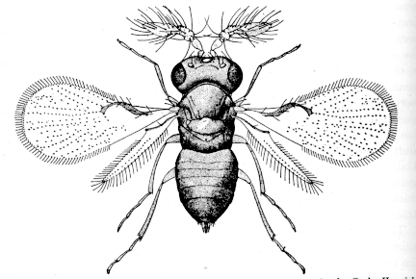
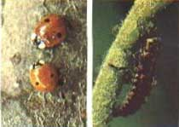
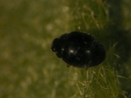
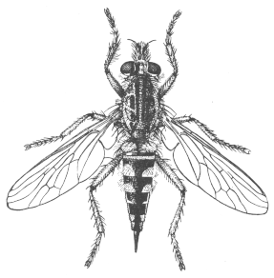

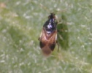
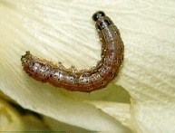
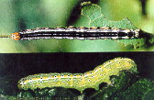
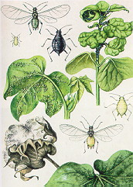
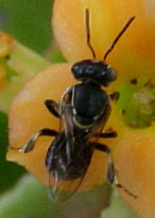
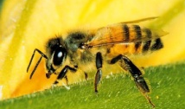
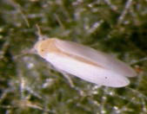
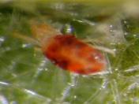
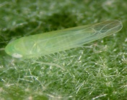
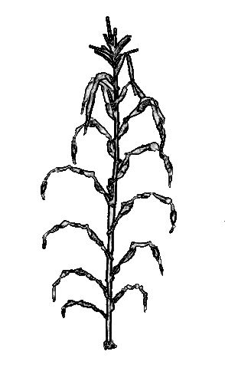
Food webs (biodiversity)
300 spp.
A. Hilbeck

Slide 13
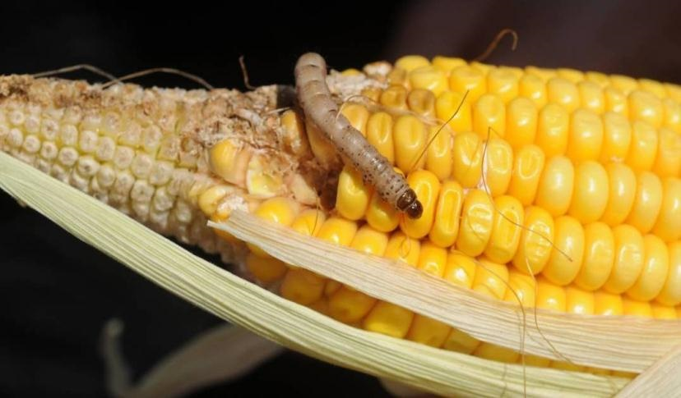
Ecology + time = evolution
Example: evolution of resistance to Bt-toxin, South Africa
Buseola fusca

Slide 14
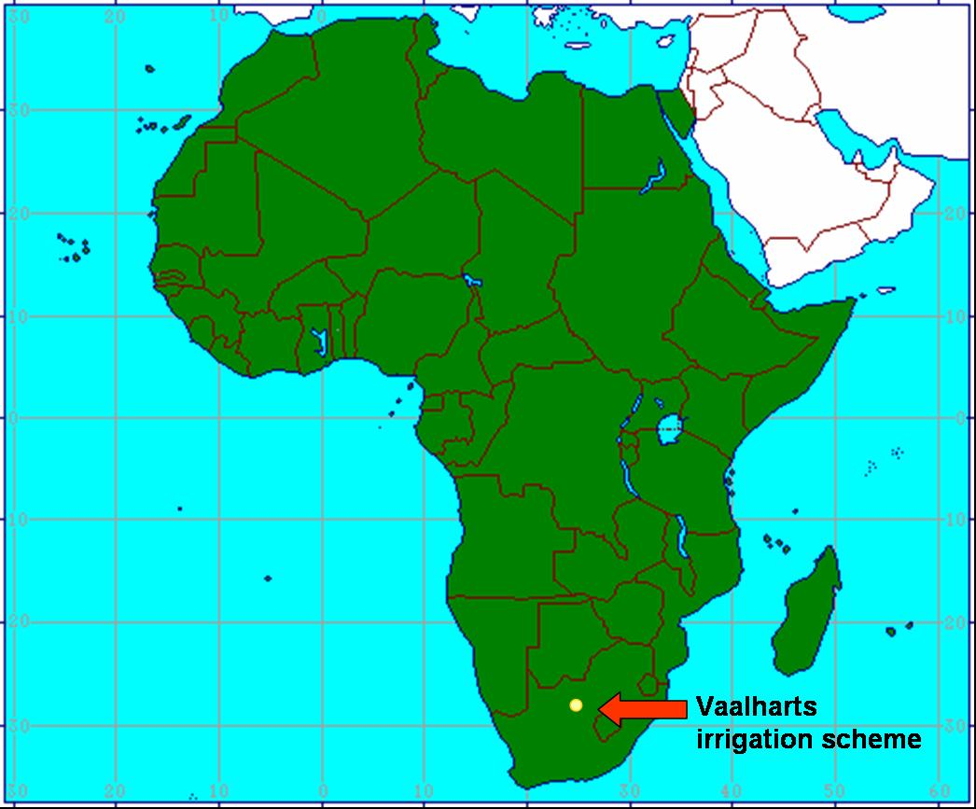
2004

Slide 15
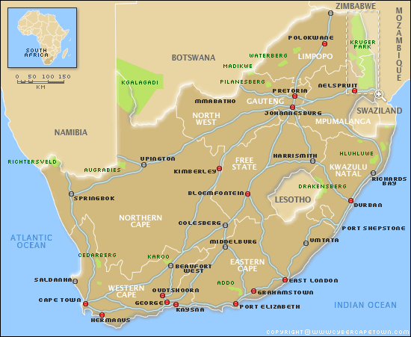
2010
2009
2004
2008
2006
Notes:
15

Slide 16
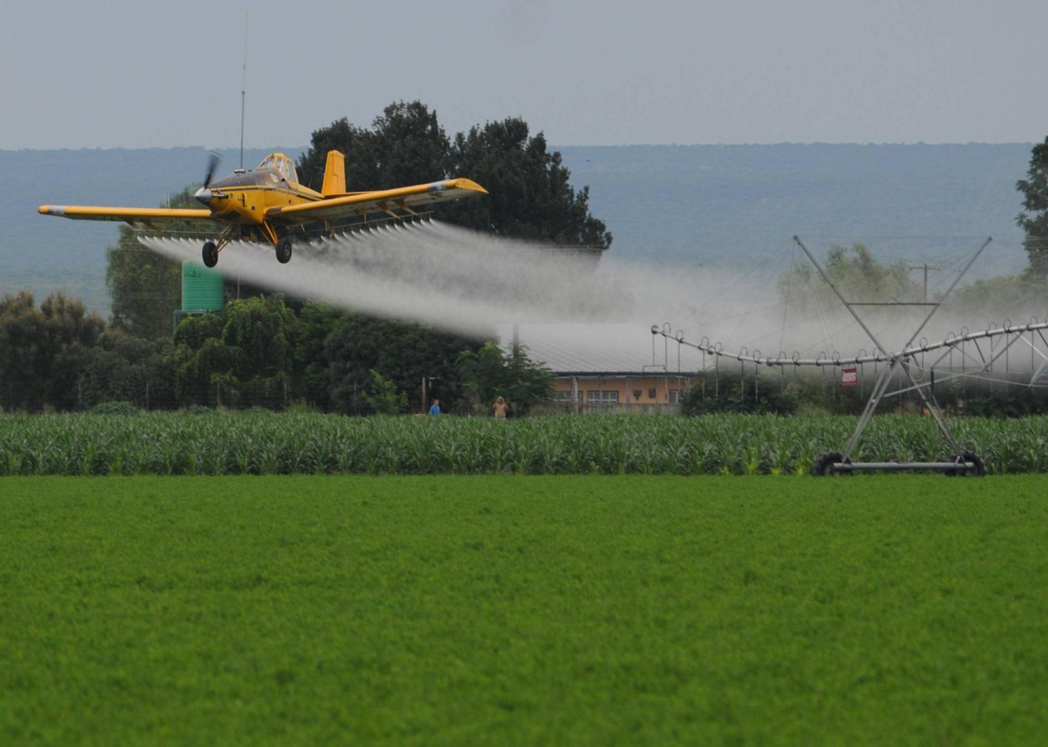
Response in South Africa:
    Spraying with pesticides
    Plants with several Bt-toxins
Notes:
16
Wider non-target effects
Possible long-term negative effects on ecosystem services

Slide 17
The Precautionary Principle
“ In order to achieve sustainable development, politics must be based on the precautionary principle. Environmental measures must anticipate, prevent and attack the causes of environmental degradation. Where there are threats of serious, irreversible damage, lack of scientific certainty should not be used as a reason for postponing measures to prevent environmental degradation”
From the Bergen Declaration, 1990, as cited by Cameron & Abouchar. Boston College International & Comparative Law Review 14: 1-28, 1991

Slide 18
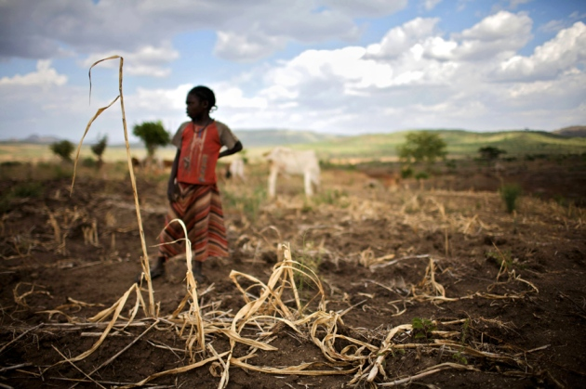
Alternative ways to improve crops
Drought resistance in maize – better success with regular breeding as compared to GM
Gilbert 2014 Cross-bred crops get fit faster - Nature
(Heinemann et al. 2014)

Slide 19
Alternative ways to improve crops
Maize yields in the US vs Europe
(Heinemann et al. 2014)

Slide 20
Conclusions
Genetic modifications give infinite opportunities for DNA re-arrangements
GM plants on the market have predominantly only two traits
  Herbicide tolerance
  Bt toxins (insect resistance)
These do not represent good and sustainable solutions
Responses to our Great Challenges must be sustainable and preserve
  Agricultural ecosystems (terrestrial, soil and aquatic ecosystem)
  Biodiversity and ecosystem services
The Precautionary Principle is a good guide
Biosafety research must be independent

Slide 21
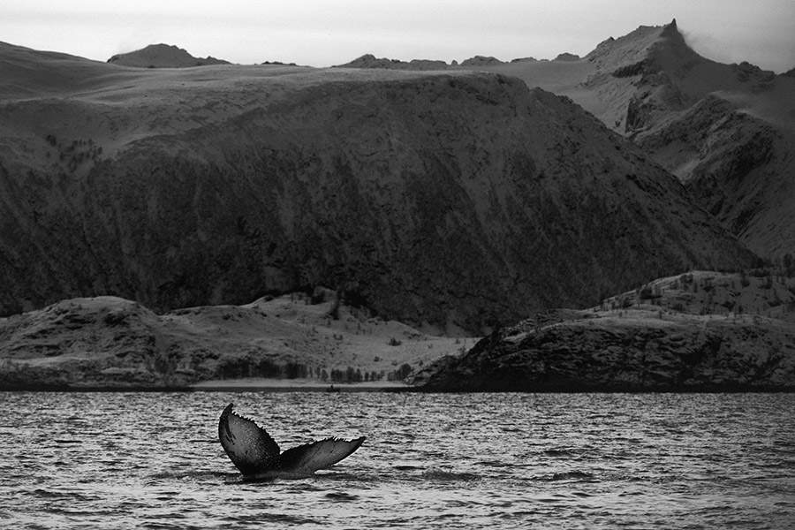
Thank you for your attention!

